Slide 1


Science Curriculum Overview 2024/25
Growing
life long
learners.

Slide 2
Our vision for growing Science at Moston Fields
We live in an increasingly scientific and technological age where children need to acquire the knowledge, skills and attitudes to prepare them for life in the 21st century.
At Moston Fields we believe science should develop an interest and curiosity about the world in which they live, and fosters in them not only a respect for the environment but a thirst to investigate the world and beyond.

Slide 3
INTENT:
Our Science Curriculum aims and the key Science skills we will teach:
Through the teaching of science our children are given the opportunities to:
Develop their knowledge and understanding of process, scientific ideas and skills and relate these to everyday experiences.
Develop and acquire a mind that questions and is curious about the world around them.
Develop the skills of investigation and observation.
Collect data, present and communicate findings to others.
Develop reasoning skills to answer questions based on outcomes of investigations.

Slide 4
IMPLEMENTATION: The Structure of the Science Curriculum at Moston Fields
Throughout the school, our science units of work are based on the answering of an enquiry question, which is linked to one aspect of the substantive knowledge.
Its through the weekly lessons, that our children are given the opportunity to develop their disciplinary knowledge and enhance their working scientifically.
The science planning builds on what prior learning has taken place and prepares them for their next steps in learning. Through the spacing between the science units of works and other subjects our children are given regular opportunities to retrieve previous knowledge. The right amount of substantive and disciplinary knowledge is taught as our school overview is underpinned by the national curriculum.
Tiered vocabulary is taught throughout each lesson.
Knowledge of key concepts is built on through repeated encounters.
Any common misconceptions that children may have are highlighted on long term planning

Slide 5
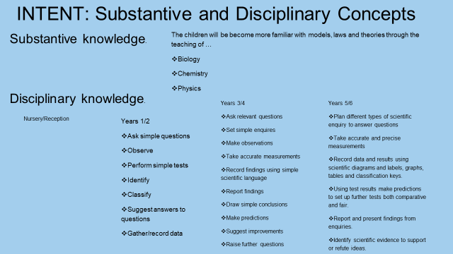
Ask scientific questions
Observe closely
Perform simple tests
Plan an enquiry
Taking measurements
Gather and record results
Interpret results

Slide 6
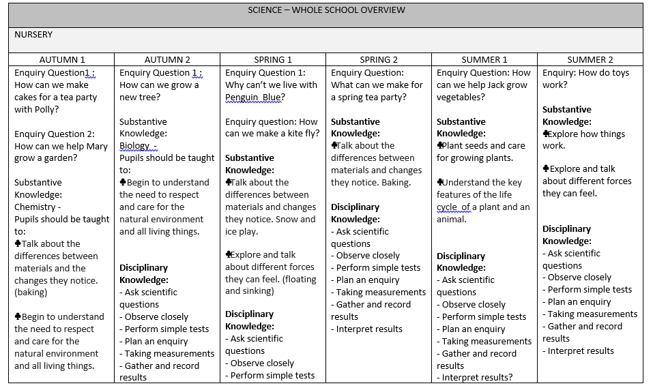

Slide 7
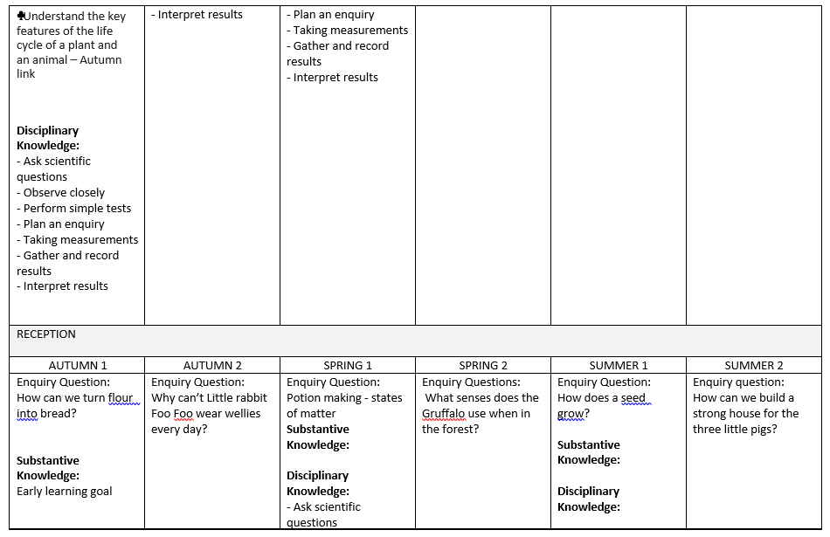

Slide 8
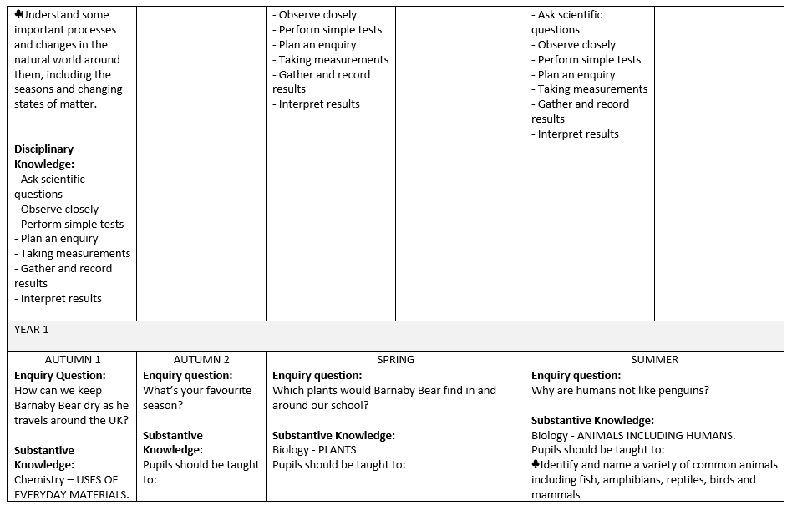

Slide 9
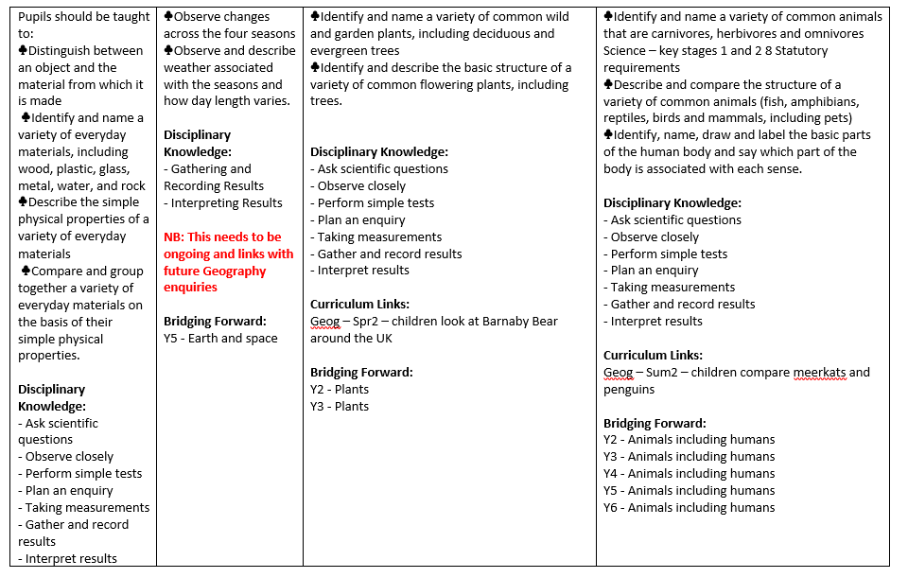

Slide 10
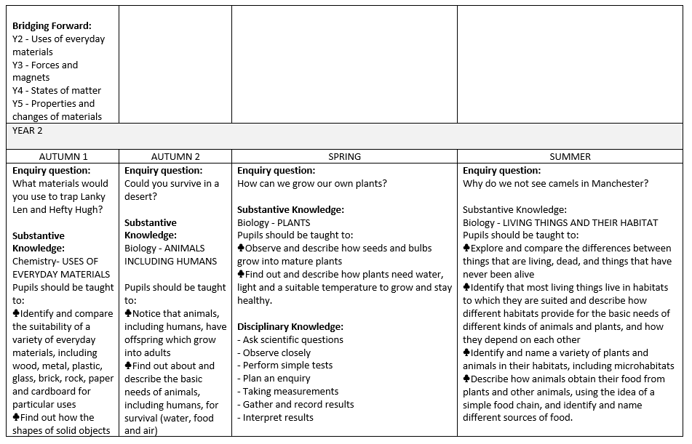

Slide 11
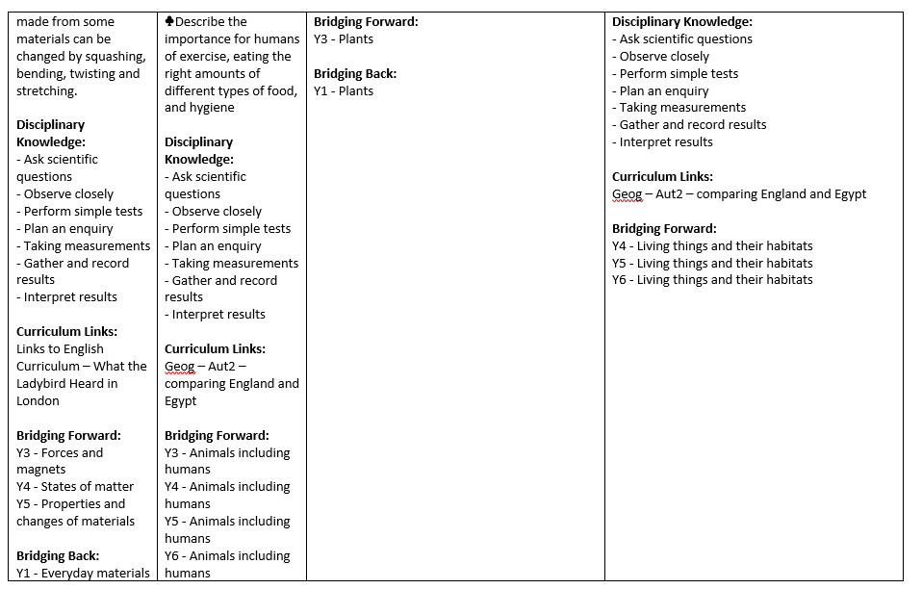

Slide 12
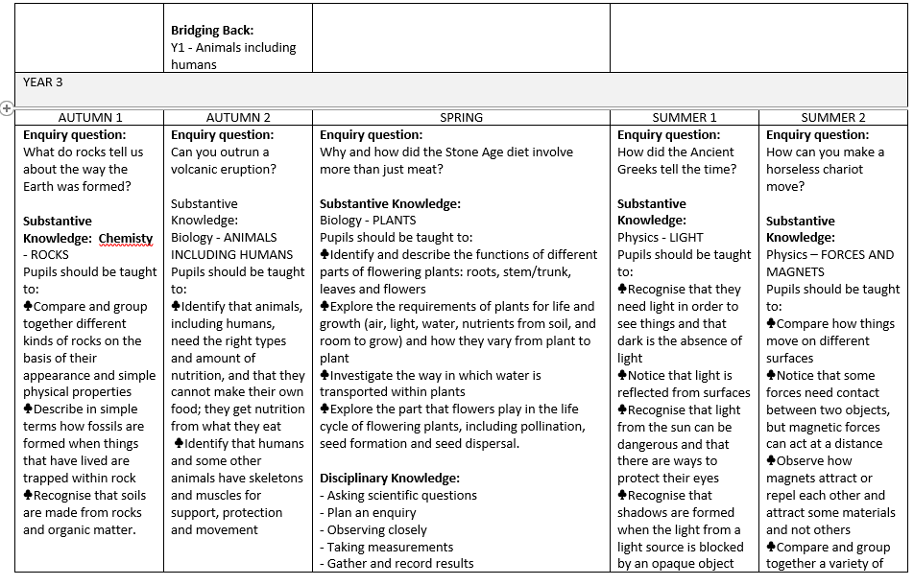

Slide 13
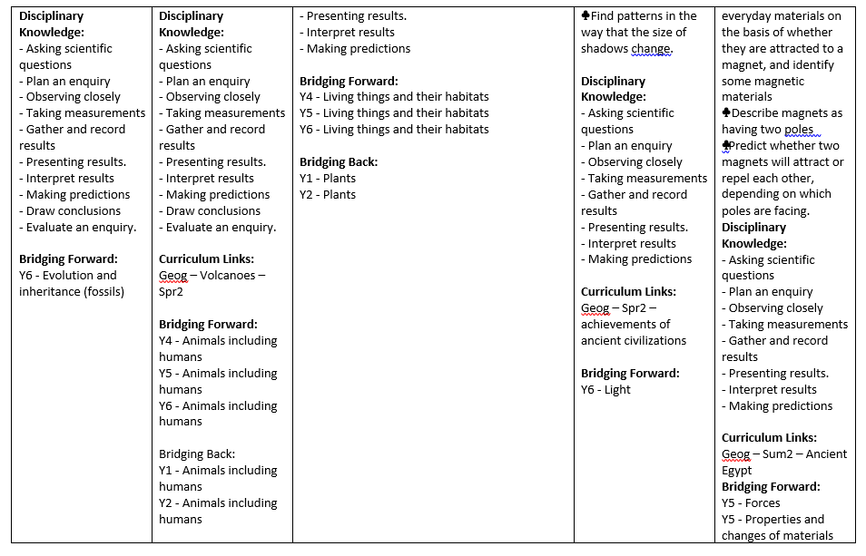

Slide 14
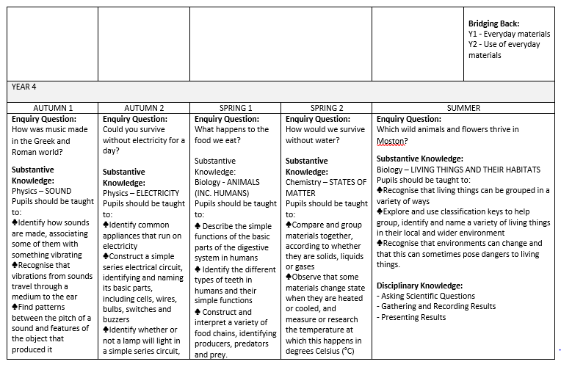

Slide 15
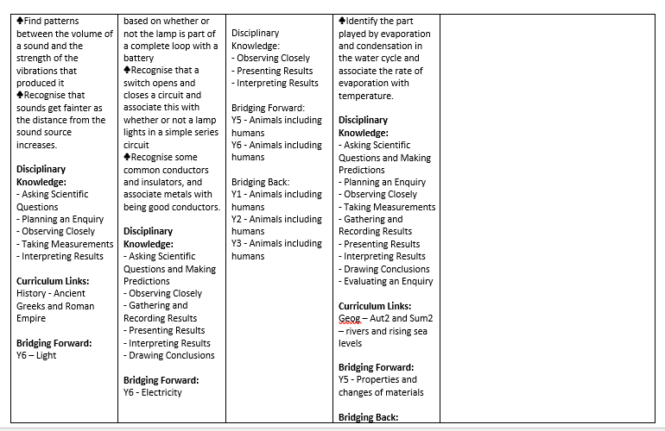

Slide 16
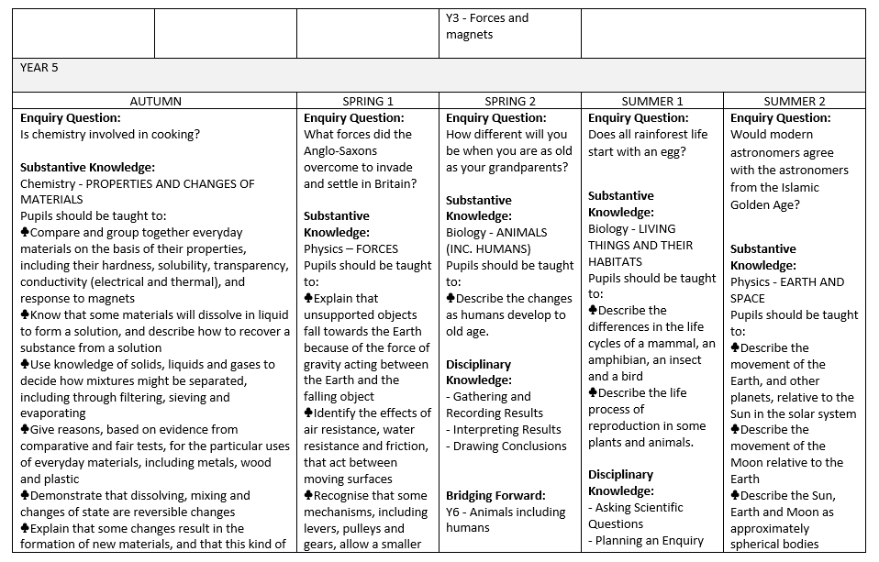

Slide 17
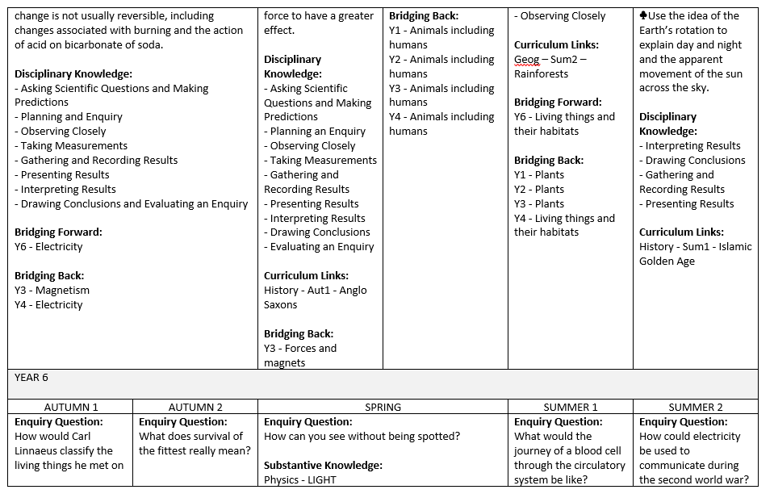

Slide 18
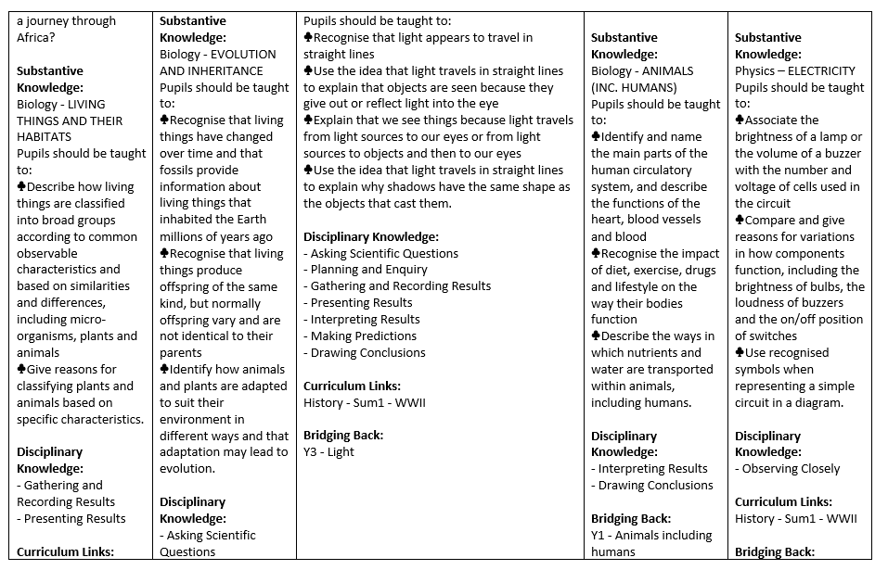

Slide 19
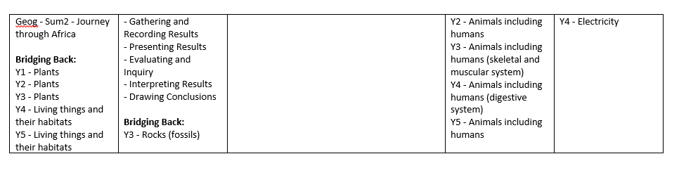

Slide 20
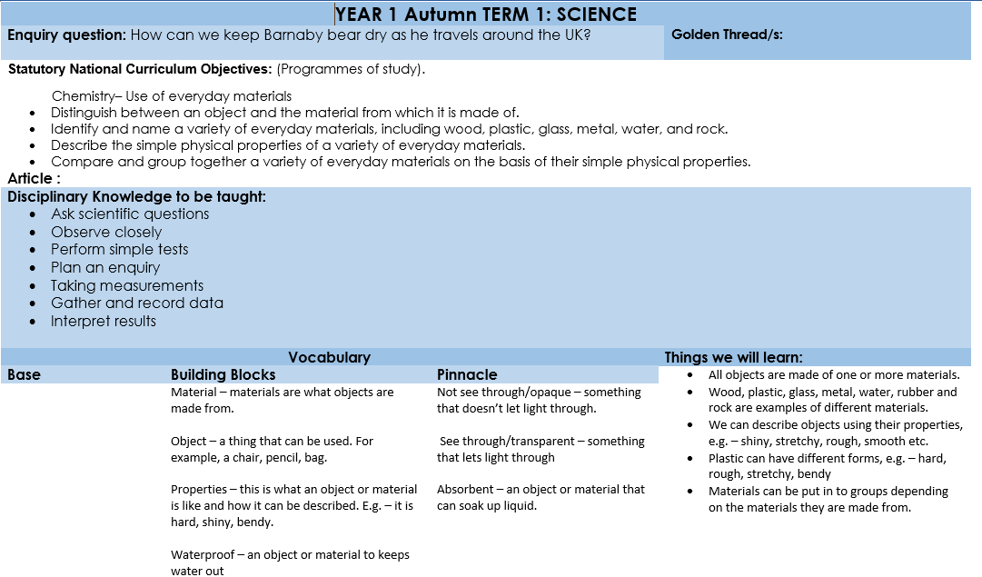
Science long term plans.

Slide 21
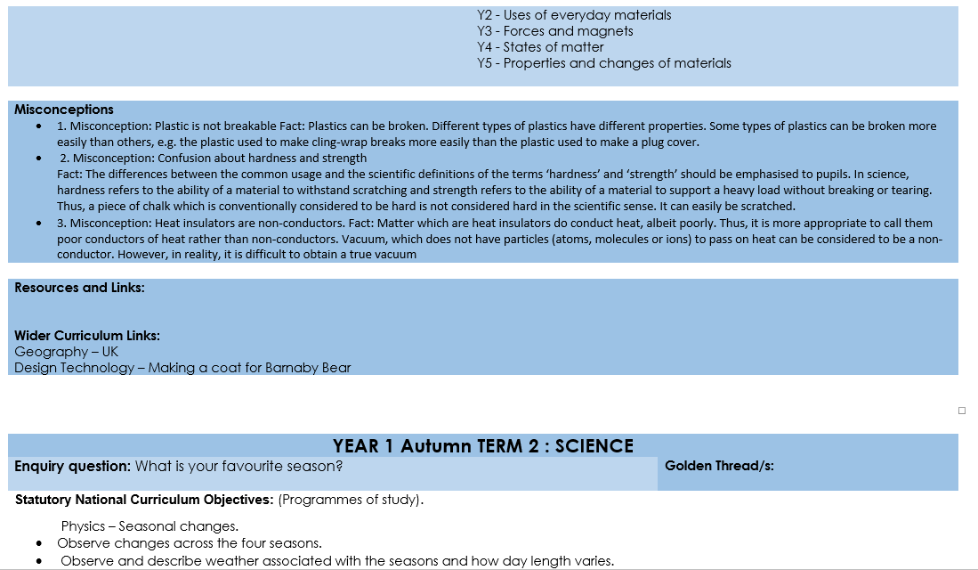

Slide 22
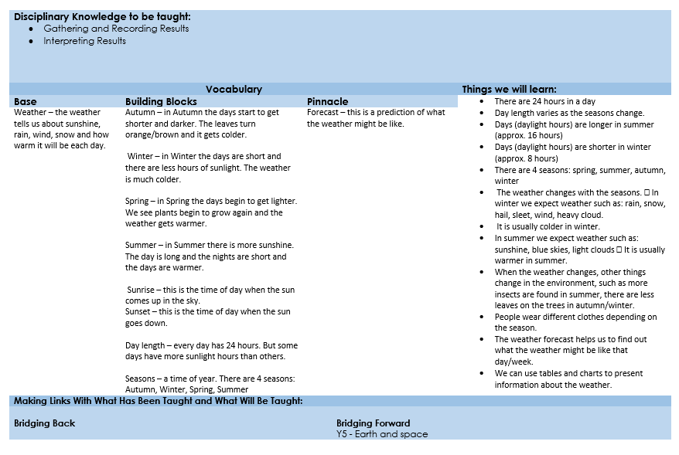

Slide 23
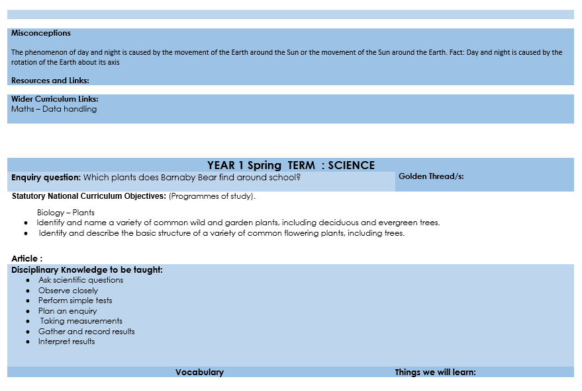

Slide 24
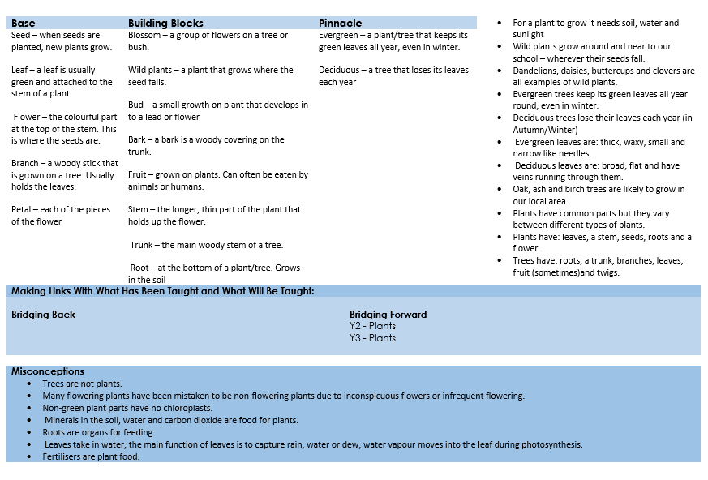

Slide 25
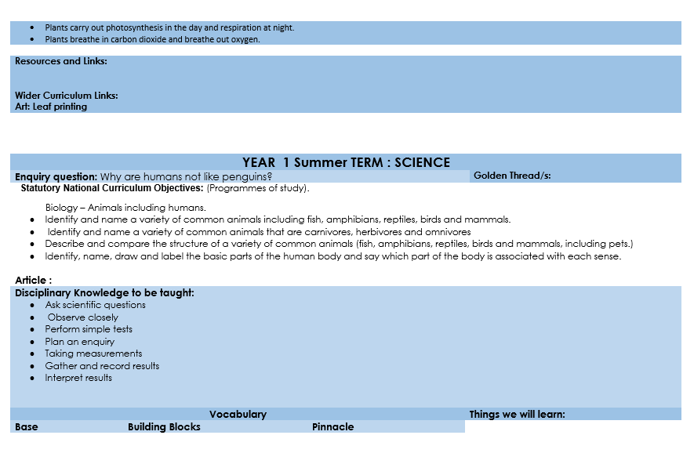

Slide 26
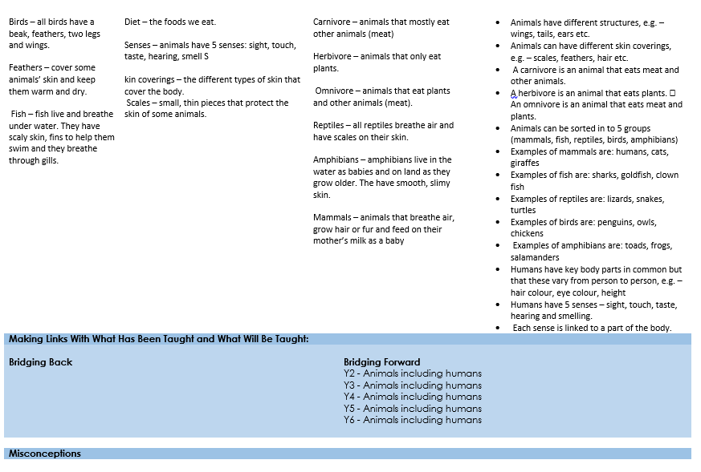

Slide 27
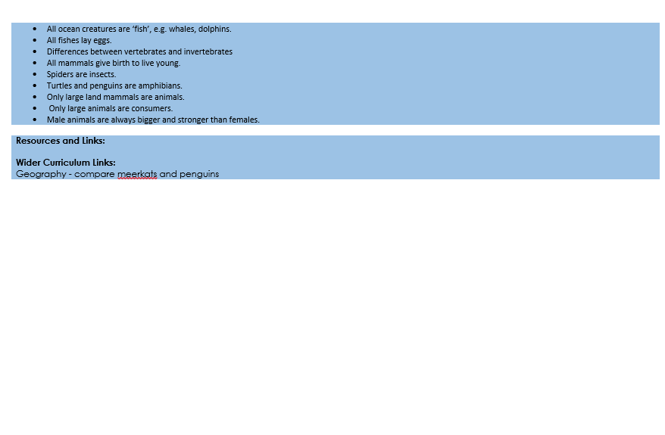

Slide 28
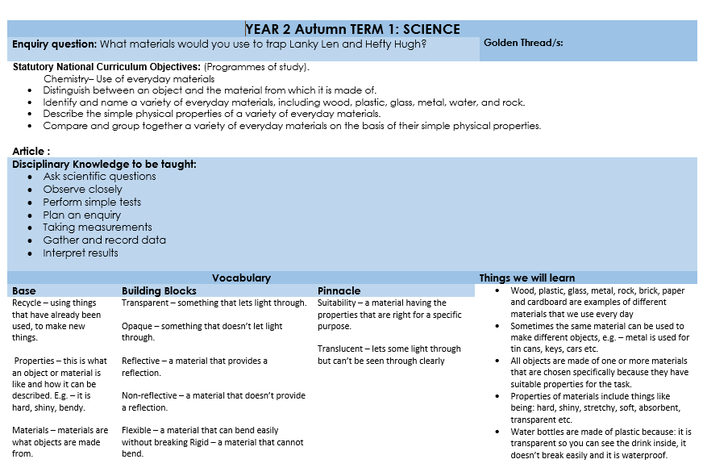

Slide 29
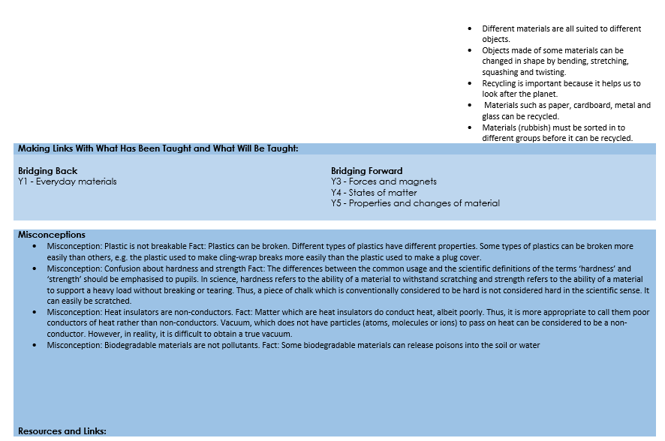

Slide 30
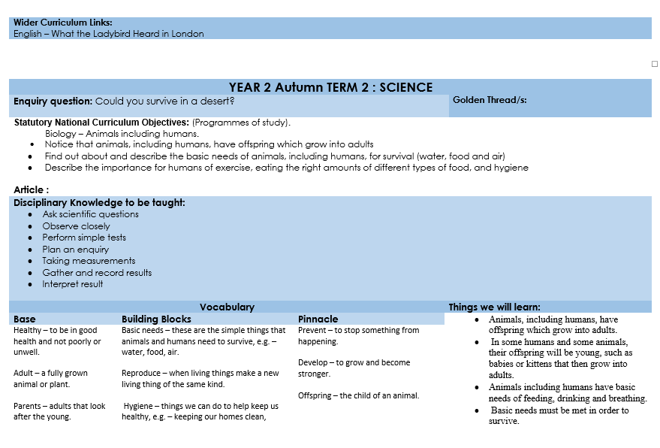

Slide 31
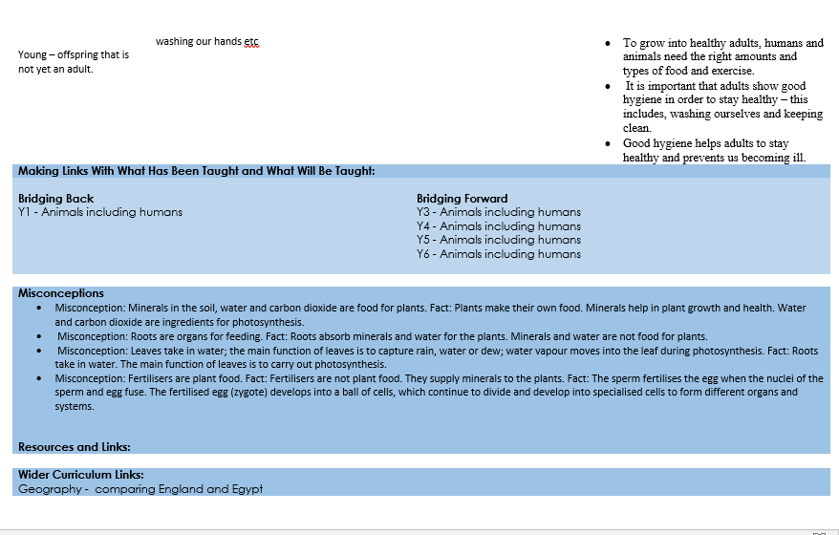

Slide 32
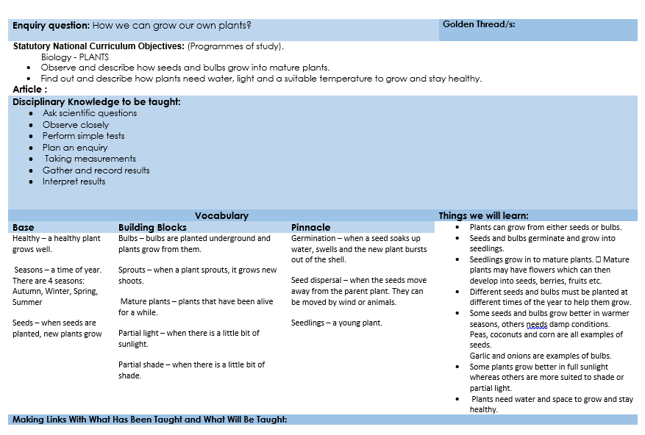

Slide 33
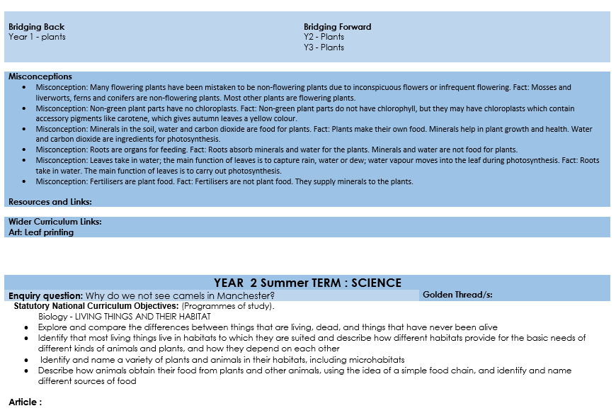

Slide 34
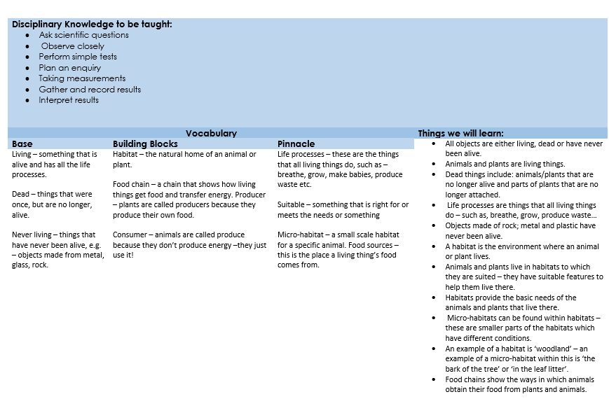

Slide 35
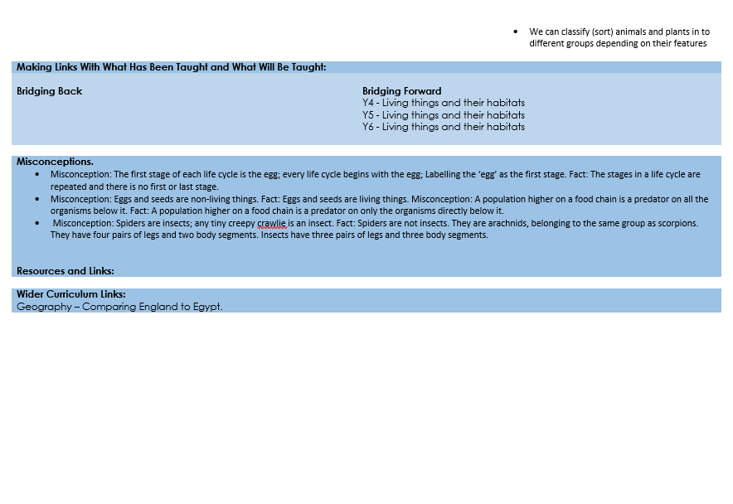

Slide 36
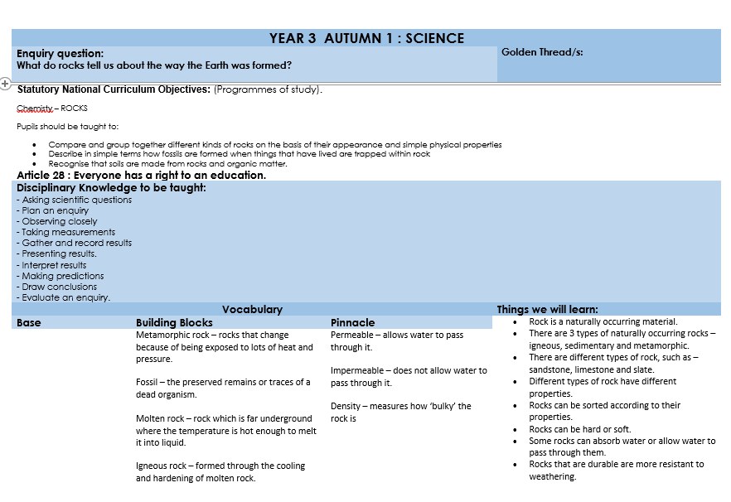

Slide 37
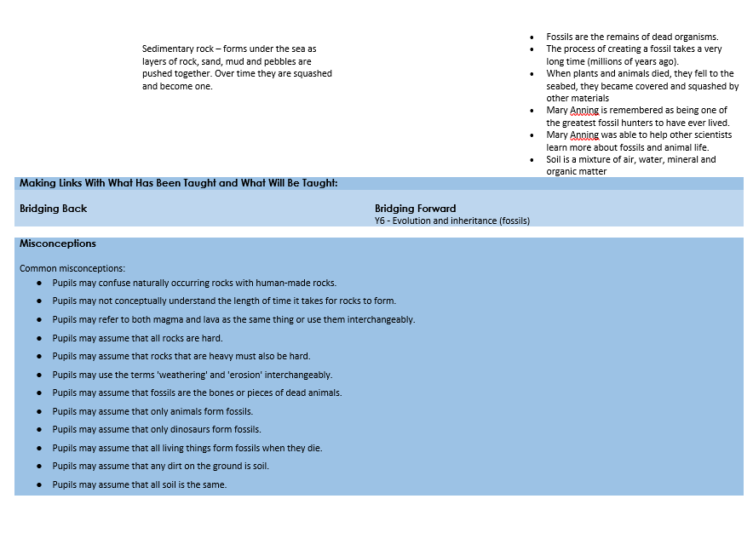

Slide 38
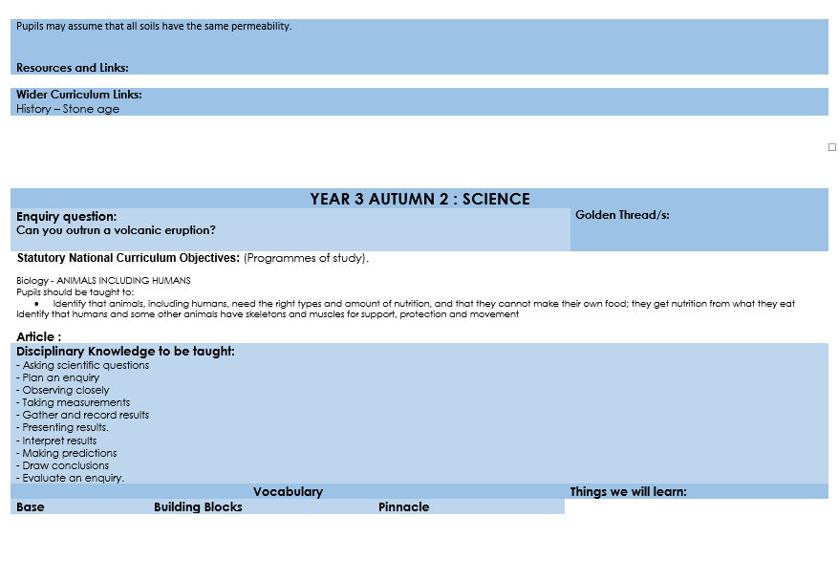

Slide 39
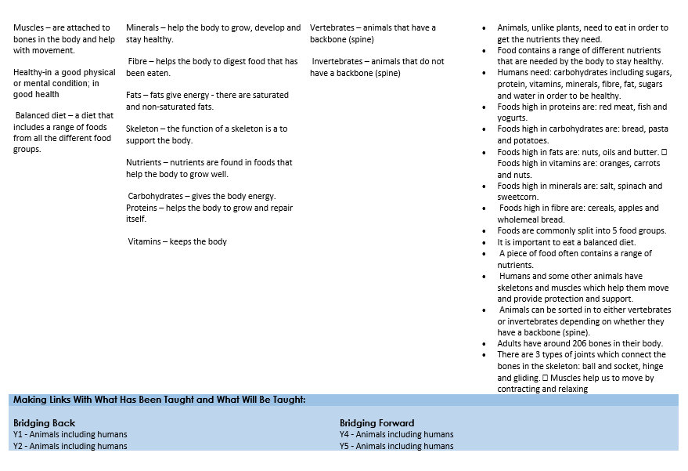

Slide 40
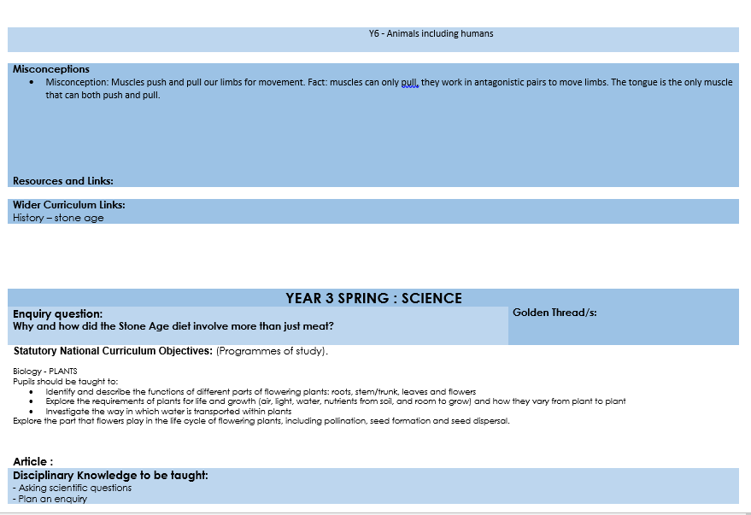

Slide 41
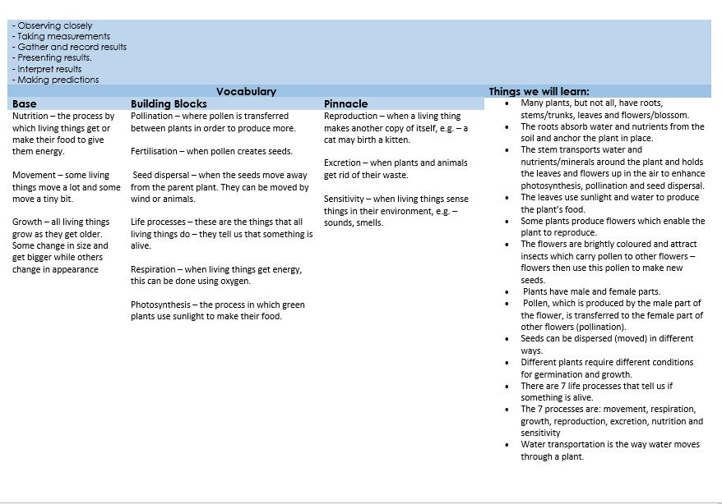

Slide 42
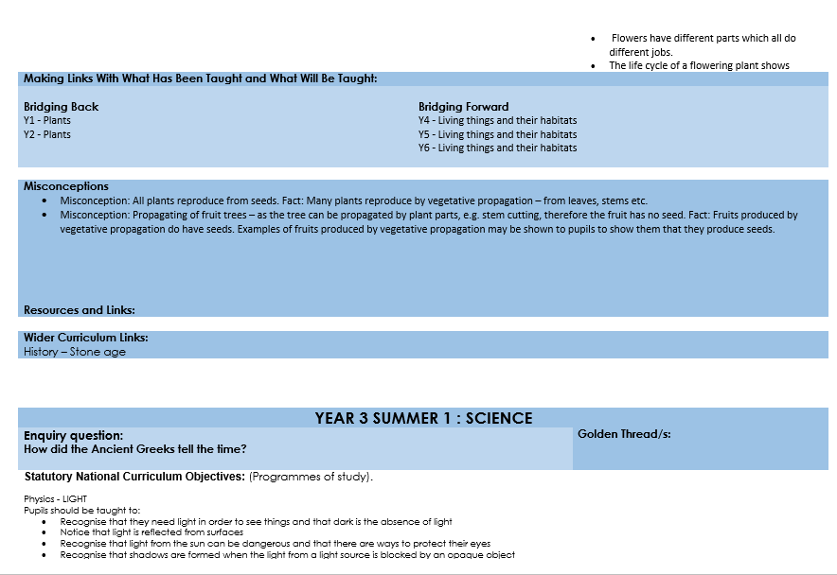

Slide 43
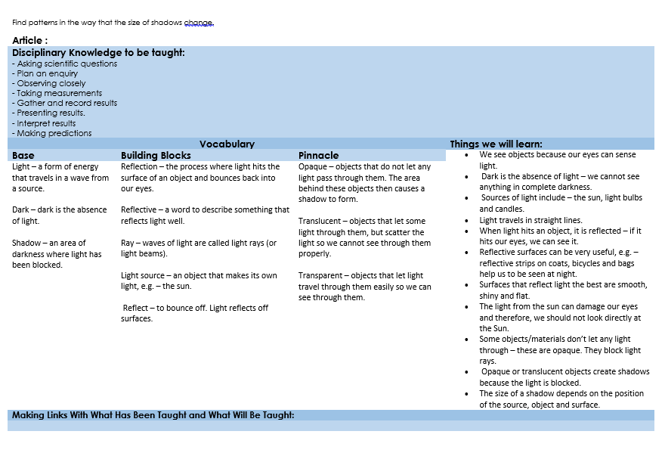

Slide 44
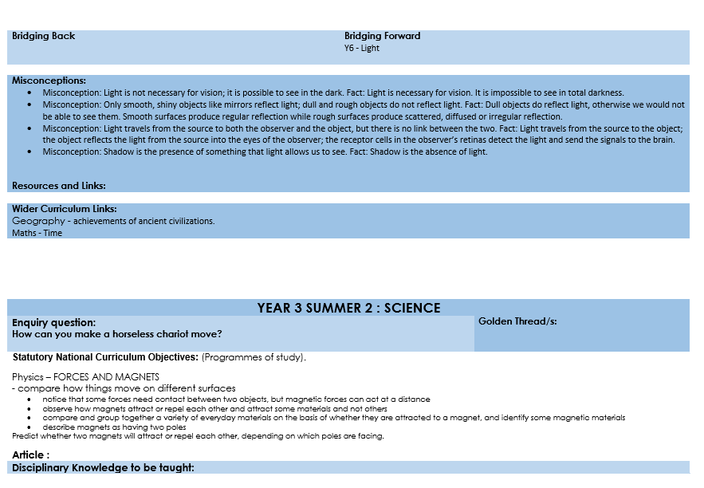

Slide 45
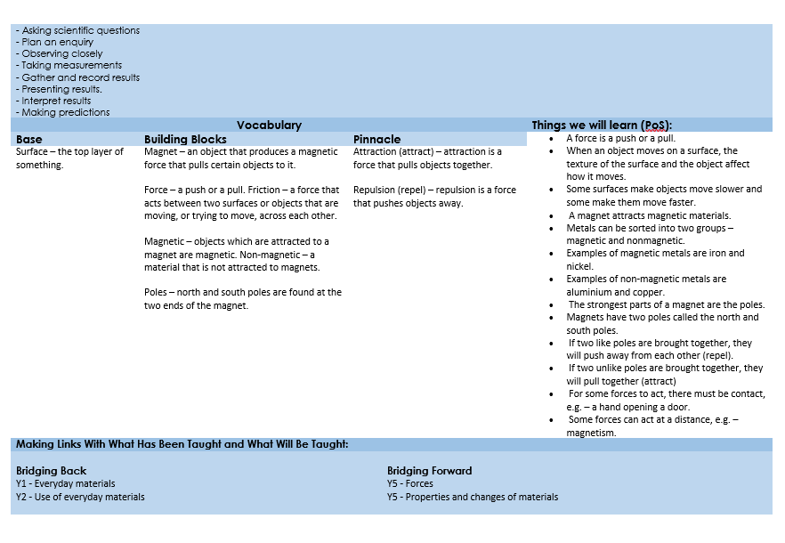

Slide 46
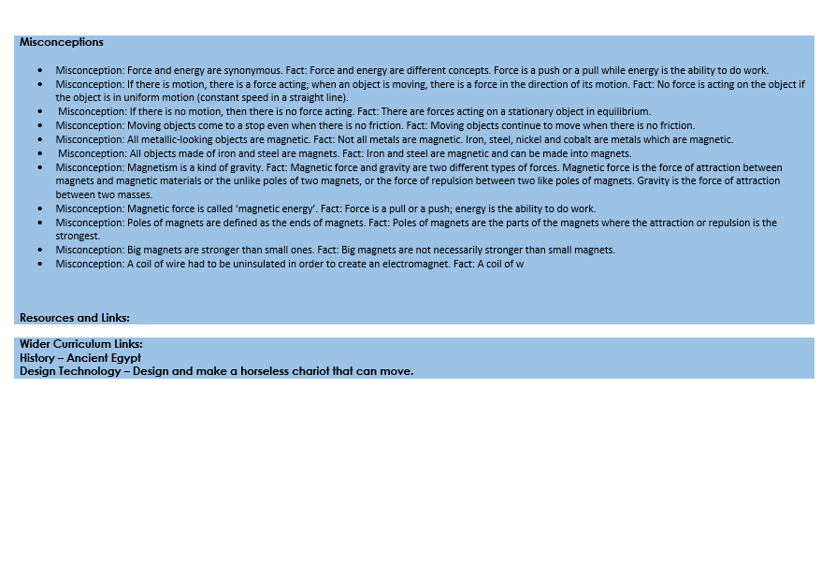

Slide 47
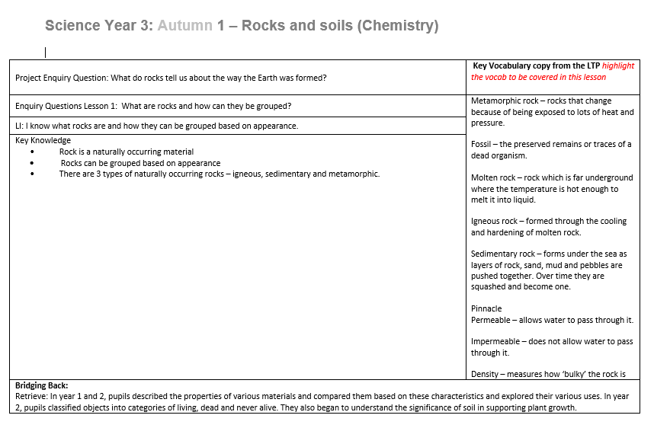
Weekly plan

Slide 48
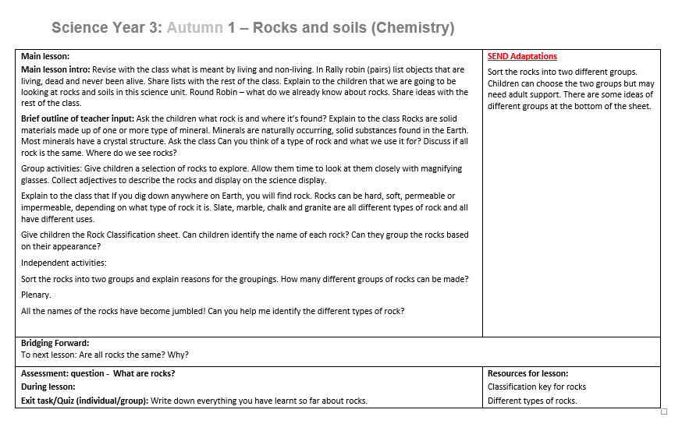

Slide 49
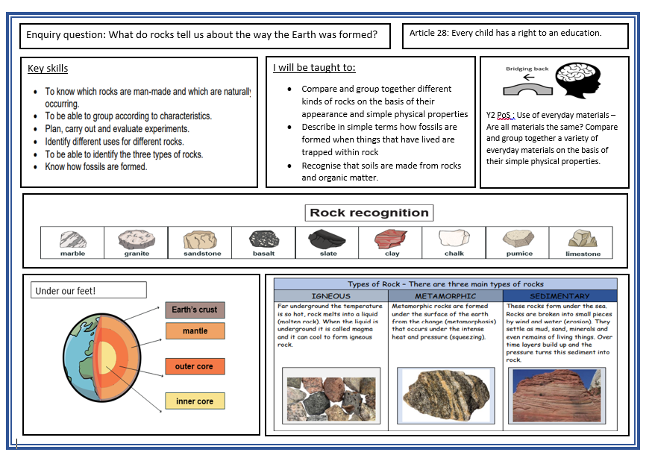
Knowledge Organiser

Slide 50
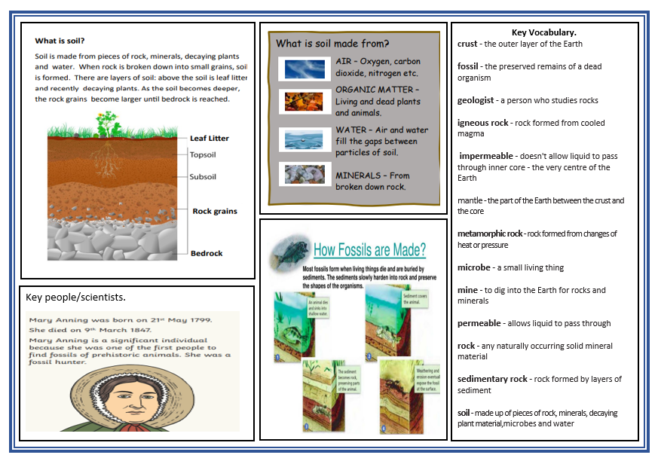

Slide 51

Our school context | Strategies to meet the needs of all learners in science
Many of our pupils speak English as an additional language, so we; | Provide opportunities for using artefacts and resources that communicate information: visuals and symbols Introduce and explain new vocabulary within the context of the lesson, using visuals and other cues to support understanding, encourage and support children to use the identified Base, Building Block and Pinnacle words in the work that they complete, give many opportunities in lessons to enable children to talk about and explain what they have learnt, working with a talk partner or in groups for support
Our pupils and families come from a wide range of cultural backgrounds, so we; | Value the backgrounds of each of the children, making connections with places and cultures they know through their studies, Make sure that our curriculum reflects important issues that have directly affected the culture and heritage of some of or in some cases all of our families: Make science lessons as practical as we can. Ensure investigations are carried out in mixed ability groups.
Nearly half of our pupils access the Pupil Premium Grant and experience socio-economic challenges, so we; | Raise aspirations by challenging all children and enabling them to experience success with their Science learning, provide opportunities for and reinforce core subject skills such as data handling, reading of non-fiction texts/excerpts with appropriate lexical vocabulary and writing skills, and provide strong, engaging teaching of Science so all children can make rapid progress in their learning Provide a Science Club that will be available for Key Stage 2 pupils, targeted at engaging some potentially marginalised pupils who show enthusiasm for Scienc.
Our school is on the outskirts of an urban, inner city area with easy access to our cultural capital, so we; | Make links in our curriculum with the significance of individuals, movements and events in Manchester that have helped to define its importance as a City, Celebrate our City, helping children to build pride in their school, their area and the City of Manchester so that they have reasons to be the Rights Respecting citizens that we aim to create
We include pupils with SEND by; | Ensuring children are aware of any out of class experiences that are different to the normal routine, using multi-sensory approaches, for example, tactile globe, wordscapes, photographs, considering barriers to learning by adapting resources and equipment such as writing frames and vocabulary sheets, teaching abstract or complex vocabulary explicitly, and ensuring children understand the aims of a unit with a clear link to the Core Learning in every lesson and in a display.

Slide 52
IMPACT: We measure the impact of our Science Curriculum through:
Monitoring pupil progress data. Identifying any underperforming groups/ individuals and adapting teaching to address this. Teachers assess attainment in Science by:
o providing an exit task for each enquiry lesson
o Assessing the retention of knowledge through an end of unit assessment for example; a
quiz or a structured Show What You Know activity
Talking to the children about their learning and asking them to talk us through their Science books.
Drop-ins in lessons and dialogue with teachers,
Friday Flicks – teachers and subject leaders look through books together, feedback informs Subject Leader support
Planning together, to create opportunities for dialogue, questions and build understanding of the delivery of the Science Curriculum at MFPS

Slide 53
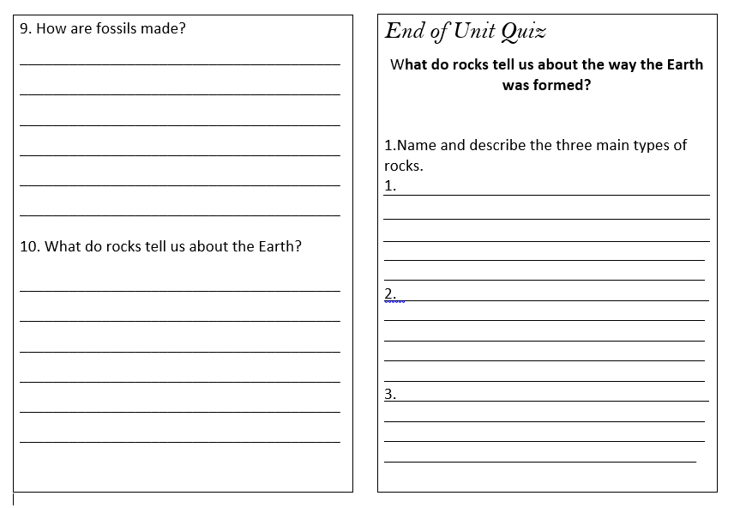

Slide 54
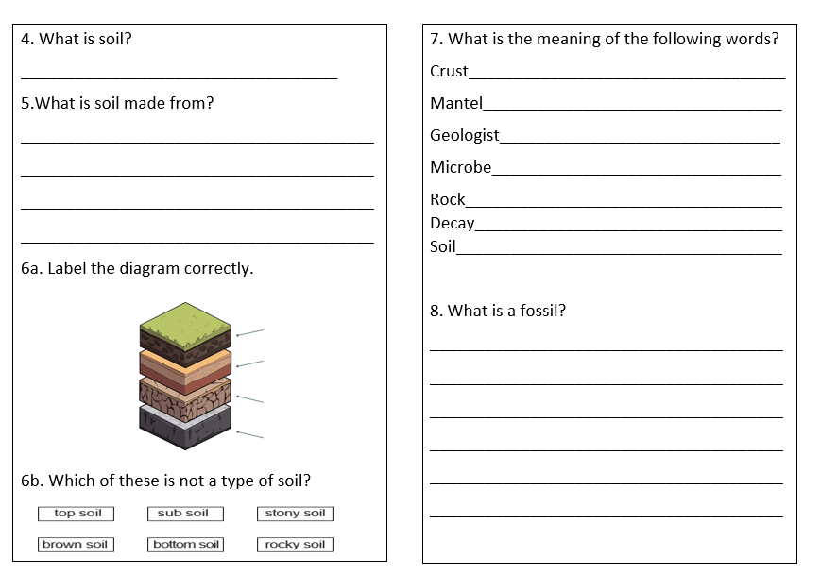

Slide 55

INTENT: Our Curriculum Design: Active ingredients
Sequenced
Planning builds on what prior learning has taken place before and prepares children for their next phase of learning.
(within year and across year groups)
Schema Building
Careful thought is given to how learning is ordered, builds and links to support encoding.
Spaced
Curriculum provides regular opportunities for retrieval of knowledge.
(within year and across year groups)
Knowledge
The right amount of substantive and disciplinary knowledge is clearly identified and taught (underpinned by the national curriculum)
Key concepts
Knowledge of key concepts is built through repeated encounters (across subjects and phases) and contextualised learning experiences
Ambitious and relevant
We have personalised high expectations for all pupils. Learning links to our pupils, is purposeful and reflects our communities.
Vocabulary
Tiered vocabulary is carefully planned into units of work.
Inspired by and developed from the CLIC Trust

