Slide 1



Curriculum Overview

Slide 2
Our vision for growing PE at Moston Fields
Through PE at Moston Fields, children will develop the skills and motivation to take part in physical activity for life. Physical and collaborative skills, that are progressive, will be taught to all children and they will have opportunities to apply them in a range of physical activities – both those that they already have a passion for and those they have not yet experienced. Outside of lessons, children will be inspired to take part in extracurricular sports and competitive events. Through this, children will enjoy and be passionate about PE and will develop their own preferences.

Slide 3
INTENT: our PE Curriculum aims and the key PE skills we will teach:
The Moston Fields PE Curriculum aims to:
Help children develop an enjoyment and love for sport.
Provide opportunities for children to develop the physical skills that will enable them to lead healthy and physically active lives.
Encourage friendly competition between peers and as part of inter-school competitions.
Key Skills for being successful in PE:
Performing a range of movements confidently.
Applying skills to team games.
Communicating, collaborating and reflecting with peers.
Competing respectfully.

Slide 4
INTENT: Substantive and Disciplinary Concepts
Through the careful planning of our spiral History Curriculum we focus on teaching the disciplinary concepts needed to understand why history is important:
Motor movement
Rules
Strategies
Tactics
Healthy Participation
We teach the substantive concepts of PE through the Golden Threads, these build over the years from Nursery up to Year 6:
Gymnastics
Dance
Fundamental movement skills
Swimming
Attacking and defending
Net and Ball
Striking and fielding
Athletics
Outdoor Adventurous Activities

Slide 5

INTENT: Our Curriculum Design: Active ingredients
Sequenced
Planning builds on what prior learning has taken place before and prepares children for their next phase of learning.
(within year and across year groups)
Schema Building
Careful thought is given to how learning is ordered, builds and links to support encoding.
Spaced
Curriculum provides regular opportunities for retrieval of knowledge.
(within year and across year groups)
Knowledge
The right amount of substantive and disciplinary knowledge is clearly identified and taught (underpinned by the national curriculum)
Key concepts
Knowledge of key concepts is built through repeated encounters (across subjects and phases) and contextualised learning experiences
Ambitious and relevant
We have personalised high expectations for all pupils. Learning links to our pupils, is purposeful and reflects our communities.
Vocabulary
Tiered vocabulary is carefully planned into units of work.
Inspired by and developed from the CLIC Trust

Slide 6
IMPLEMENTATION: The Structure of the PE Curriculum at Moston Fields
The Key principles in the way our XXX curriculum has been developed:
In

Slide 7
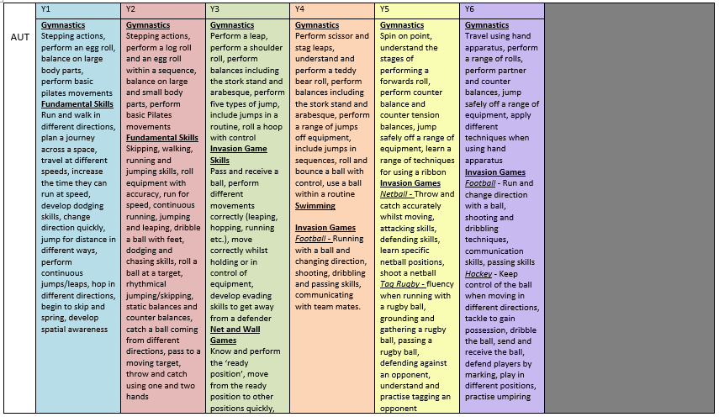
Long term overview of PE

Slide 8
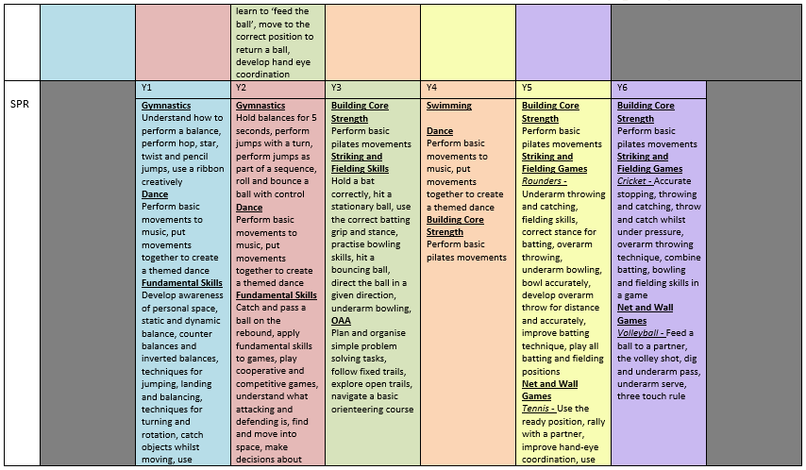

Slide 9
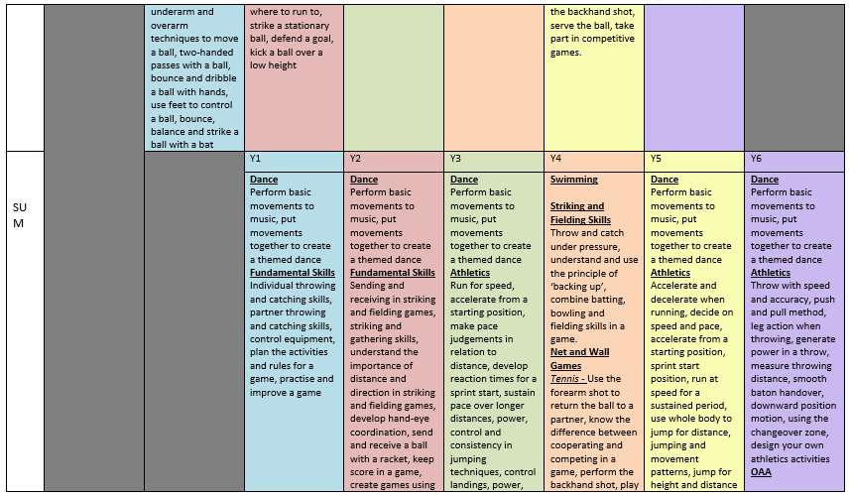

Slide 10
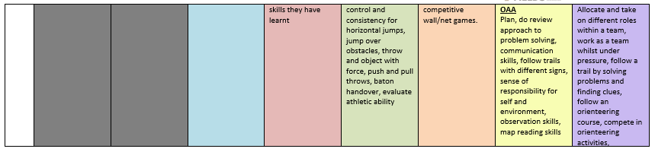

Slide 11
IMPLEMENTATION: The Way PE is Taught at Moston Fields
The Active Ingredients in our PE lessons that we are implementing and developing this year are:
Each lesson will begin with bridging back, to the previous lesson, term or year, whichever is most appropriate.
Each lesson will focus on developing a physical skill with opportunities to practice the skill in isolation.
There will be opportunities to apply skills in games in every lesson. The complexity of games will develop throughout each unit.
Each lesson will include opportunities to reflect on pupils’ performance of the physical skills taught and their communication and collaboration.

Slide 12
Our school context | Strategies to meet the needs of all learners in PE.
Many of our pupils speak English as an additional language, so we; | Provide opportunities for using artefacts and resources that communicate information: maps, visuals, artefacts and symbols Introduce and explain new vocabulary within the context of the lesson, using visuals and other cues to support understanding, encourage and support children to use the identified Base, Building Block and Pinnacle words in the work that they complete, use visits and visitors as a way of bringing to life the historical learning, such as an Anglo-Saxon workshop (Y5) a Great Fire of London workshop (Year 2) a trip to a museum such as the Liverpool Slaves Trade Museum (Y6) give many opportunities in lessons to enable children to talk about and explain what they have learnt, working with a talk partner or in groups for support
Our pupils and families come from a wide range of cultural backgrounds, so we; | Value the backgrounds of each of the children, making connections with places and cultures they know through their studies, Make sure that our curriculum reflects important issues that have directly affected the culture and heritage of some of or in some cases all of our families: the Slave Trade enquiry (Y6) Peterloo Massacre (Y6) the changes in women’s roles and the suffragettes (Y6) and provide project based homework linked to History, so children can learn alongside their family.
Nearly half of our pupils access the Pupil Premium Grant and experience socio-economic challenges, so we; | Raise aspirations by challenging all children and enabling them to experience success with their History learning, provide opportunities for and reinforce core subject skills such as data handling, reading of non-fiction texts/excerpts with appropriate lexical vocabulary and writing skills, and provide strong, engaging teaching of History so all children can make rapid progress in their learning Provide a History Club that will be available to Upper Key Stage 2 pupils, targeted at engaging some potentially marginalised pupils who show enthusiasm for History
Our school is on the outskirts of an urban, inner city area with easy access to our cultural capital, so we; | Make links in our curriculum with the significance of individuals, movements and events in Manchester that have helped to define its importance as a City, Make links with local teams to provide more opportunities for children. Celebrate the supporting successes of Manchester and promote the many opportunities for participating in and spectating sport across the city. Provide opportunities to take part in activities away from the city, that they may not normally access.
We include pupils with SEND by; | Ensuring children are aware of any out of class experiences that are different to the normal routine, using multi-sensory approaches, for example, tactile globe, wordscapes, photographs, considering barriers to learning by adapting resources and equipment such as writing frames and vocabulary sheets, teaching abstract or complex vocabulary explicitly, for example, erosion, climate and how direction language leads into compass points, and ensuring children understand the aims of a unit with a clear link to the Core Learning in every lesson and in a display.

Slide 13
IMPACT: We measure the impact of our PE Curriculum through:
Monitoring pupil progress data. Identifying any underperforming groups/ individuals and adapting teaching to address this. Teachers assess attainment in History by:
o providing an exit task for each enquiry lesson
o completing timeline work for each historical unit that shows a level of progression
o Assessing the retention of knowledge through an end of unit assessment for example; a
quiz or a structured Show What You Know activity
Talking to the children about their learning and asking them to talk us about their learning in PE lessons.
Drop-ins in lessons and dialogue with teachers,
Planning together, to create opportunities for dialogue, questions and build understanding of the delivery of the History Curriculum at MFPS

