Slide 1

What is identity?
Notes:
Freepik- doodles
Freepik - Images of children

Slide 2
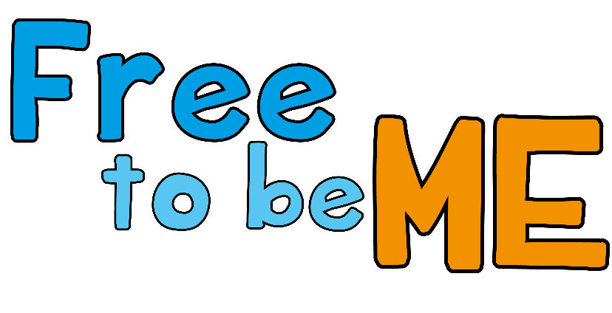
Exploring our identity online
ARTICLE 17: Your right to have honest information
ARTICLE 19: Your right to be kept safe from harm
Notes:
Freepik- doodles
Freepik - Images of children

Slide 3


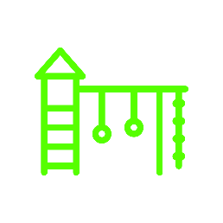










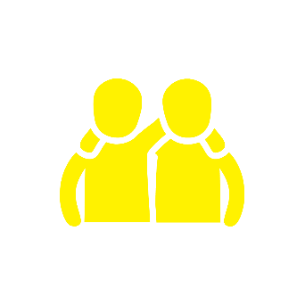

What makes me… me?
Notes:
Noun project, Shuttertock - images

Slide 4
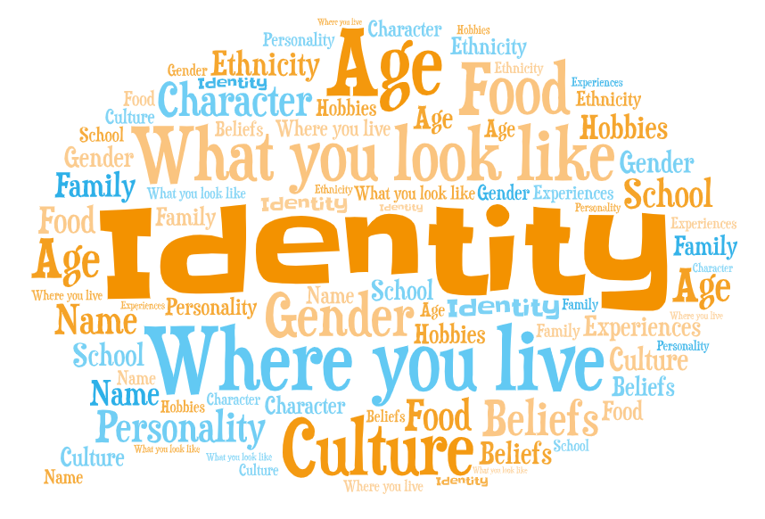

Notes:
https://emojipedia.org – Emoji head

Slide 5

Have you ever…

Slide 6
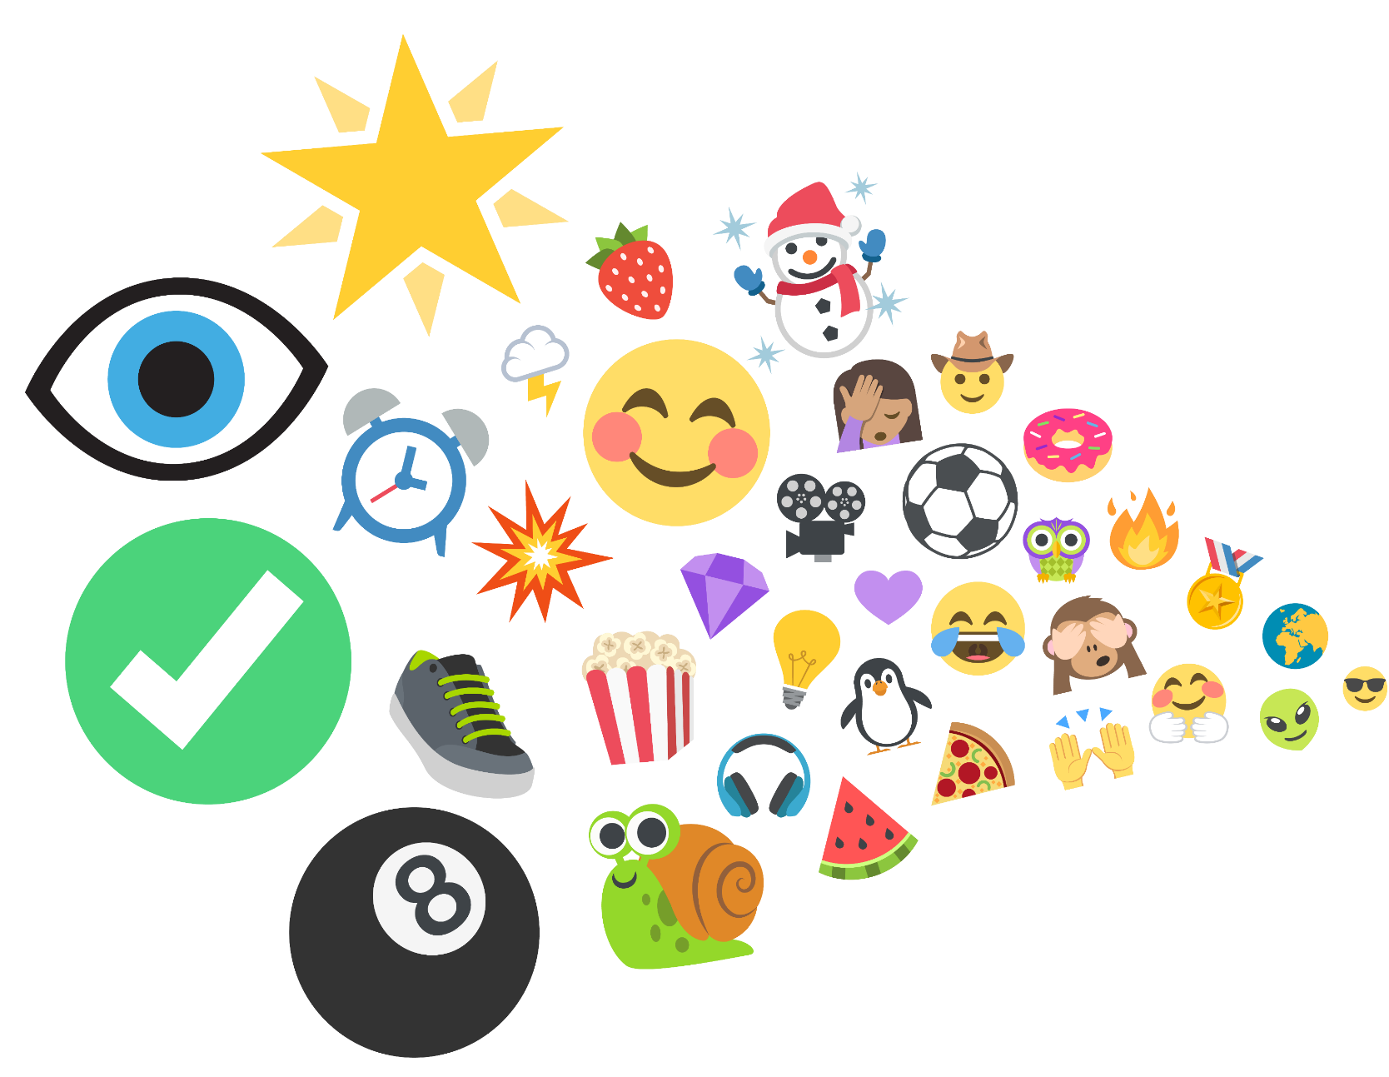
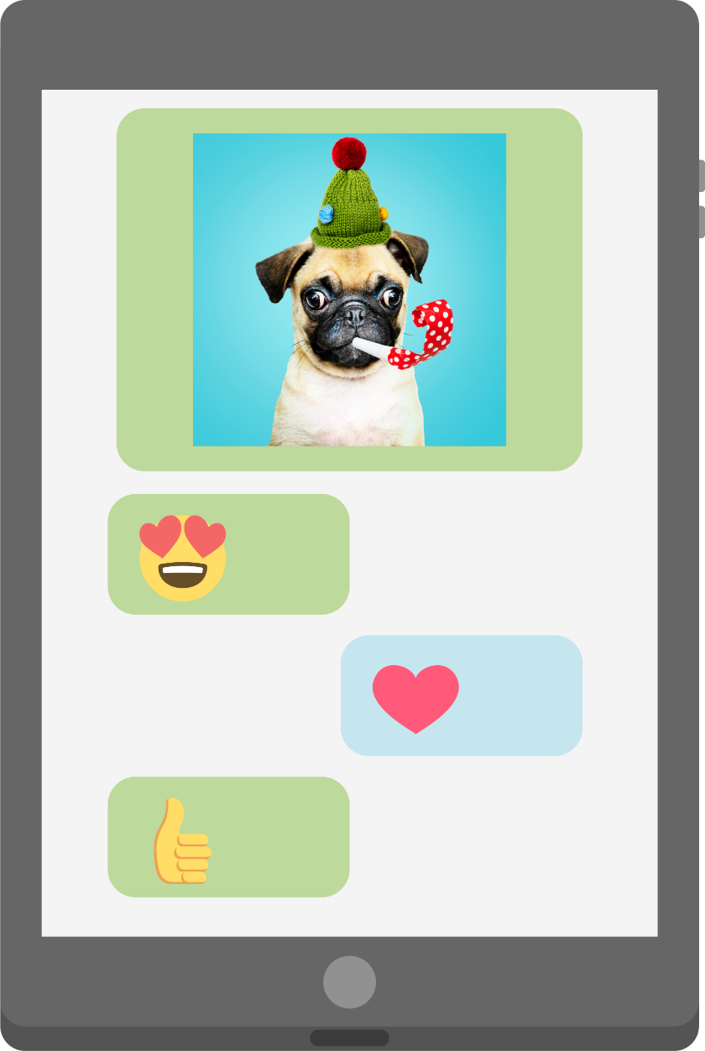
…used an emoji?
Notes:
Shutterestock – tablet
Freepik – dog photo
Emojis from-
https://www.joypixels.com/emoji#all

Slide 7
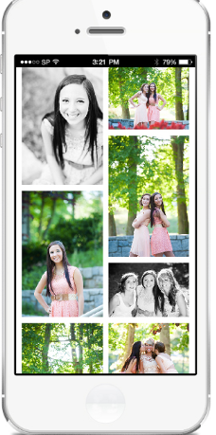
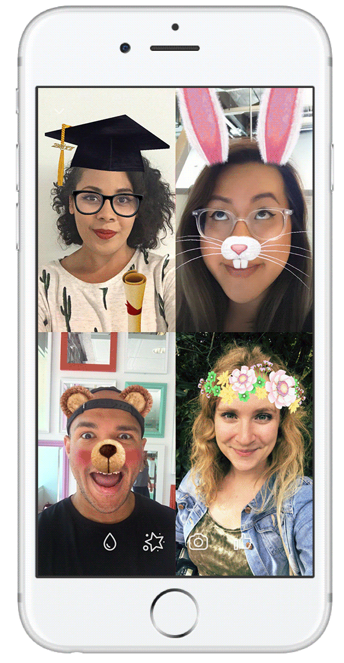
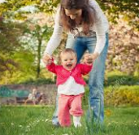
…put a photo online?
Notes:
© Facebook

Slide 8
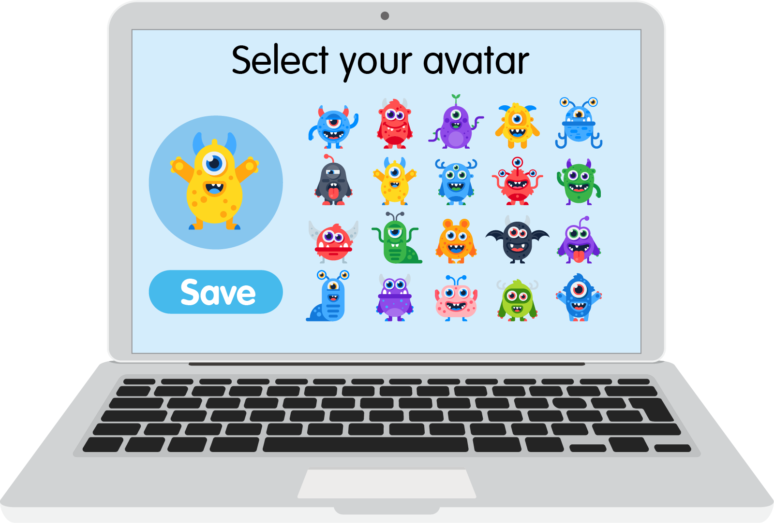
… created or chosen an avatar or character?

Slide 9
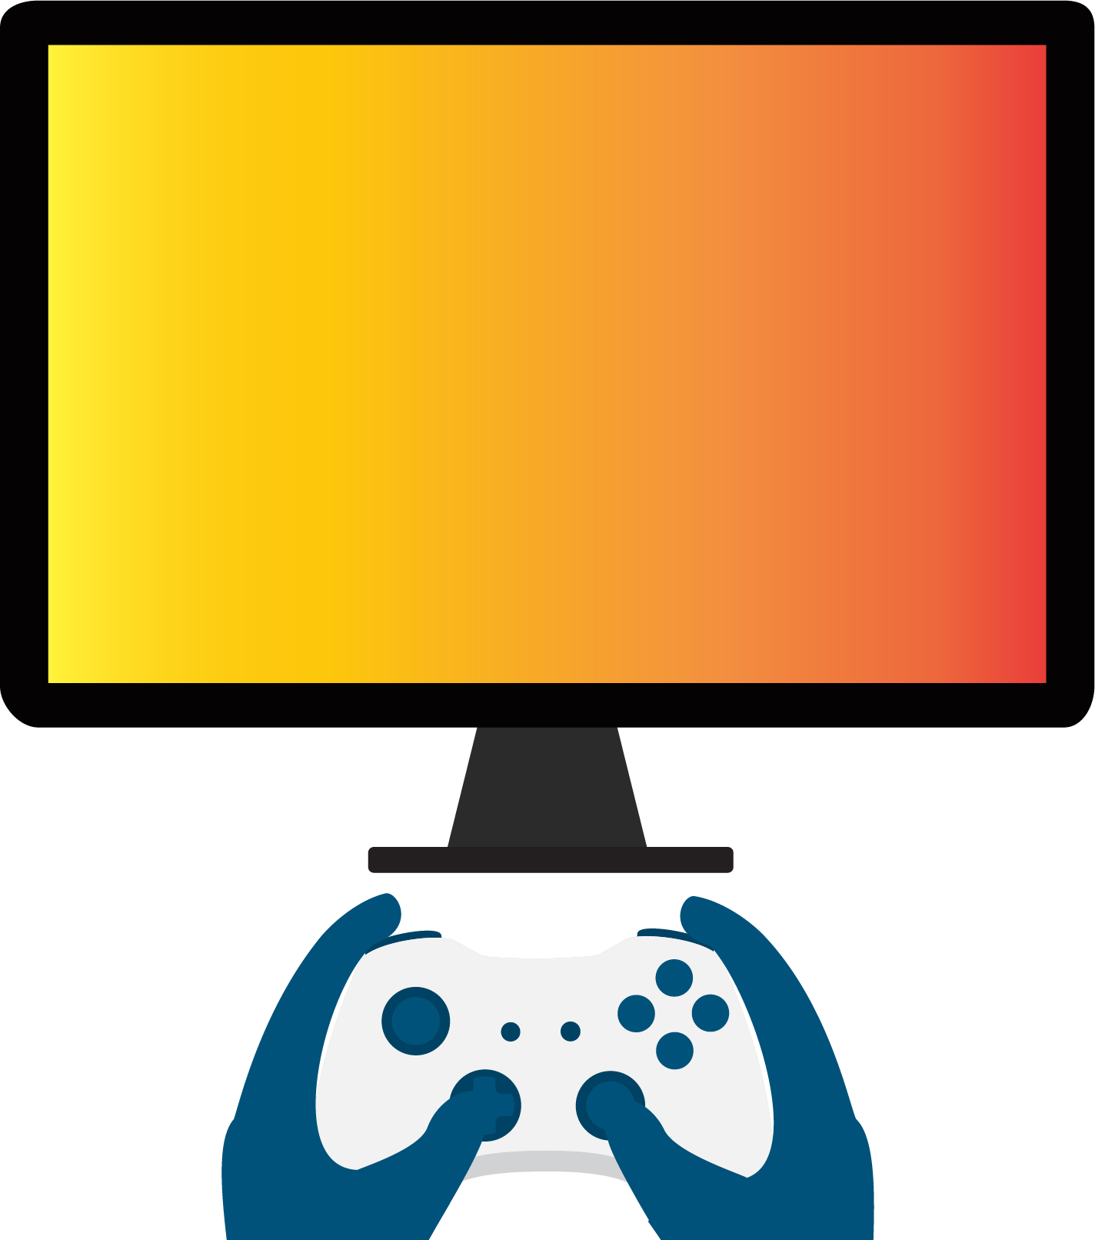
Username | Online
Gamer_girl467 | Yes
Jo.pizzaboss.73- | Yes
sleepy_meerkat | No
_Flying.fox.55 | Yes
mega.Millie | No
Invisible_penguin23 | No
xX-PLY2WIN-Xx | No
lucky-dimond.01 | No
…chosen a username?

Slide 10
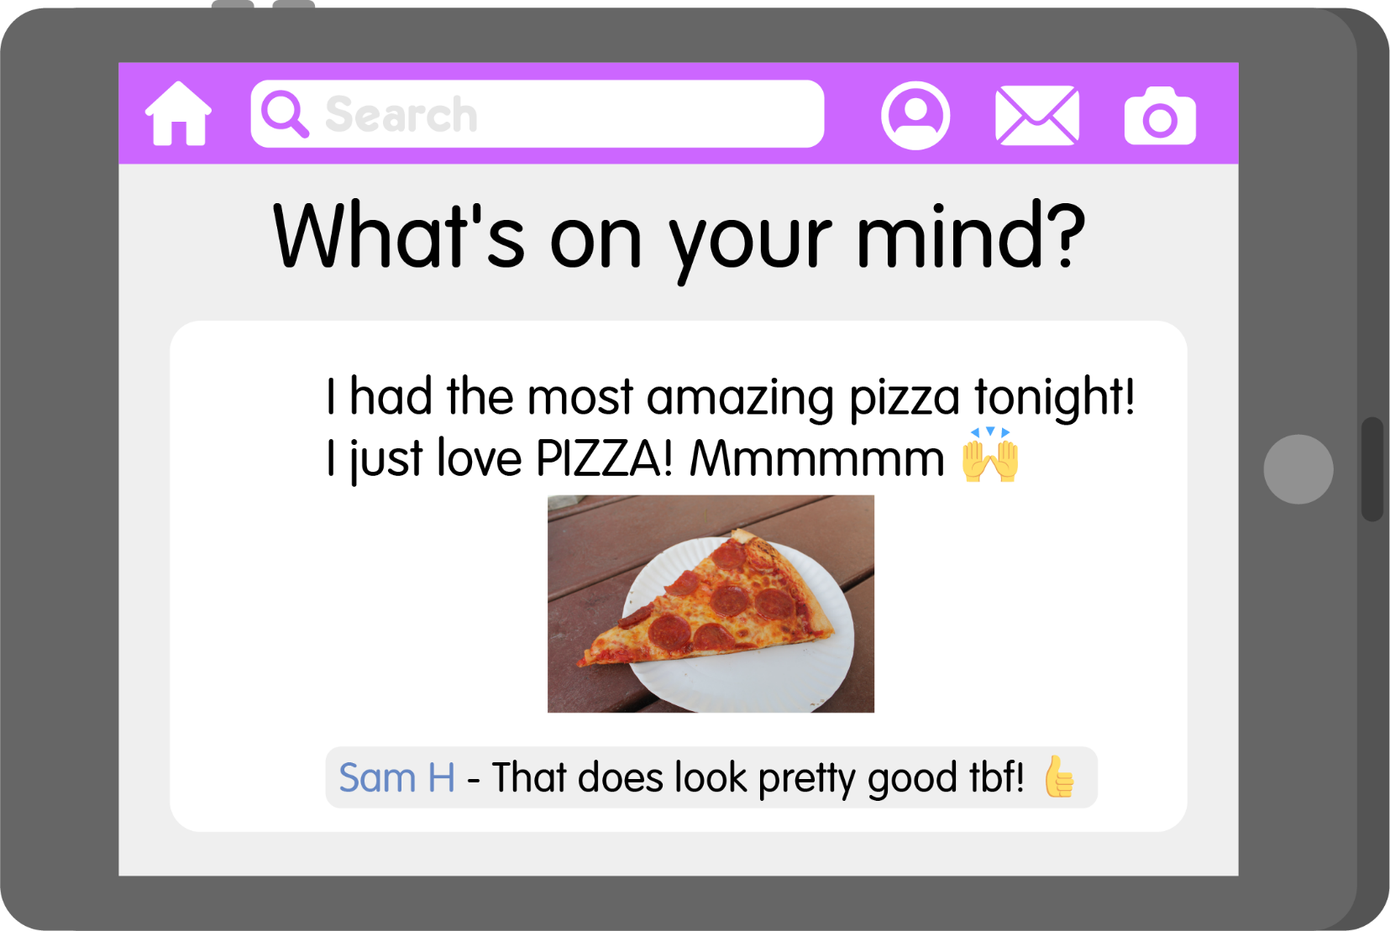
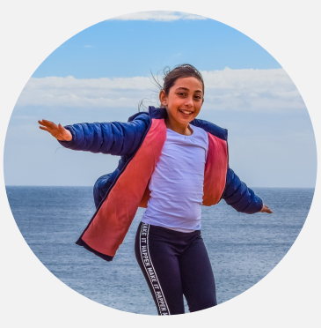
… shared something online about yourself or the things you like to do?

Slide 11
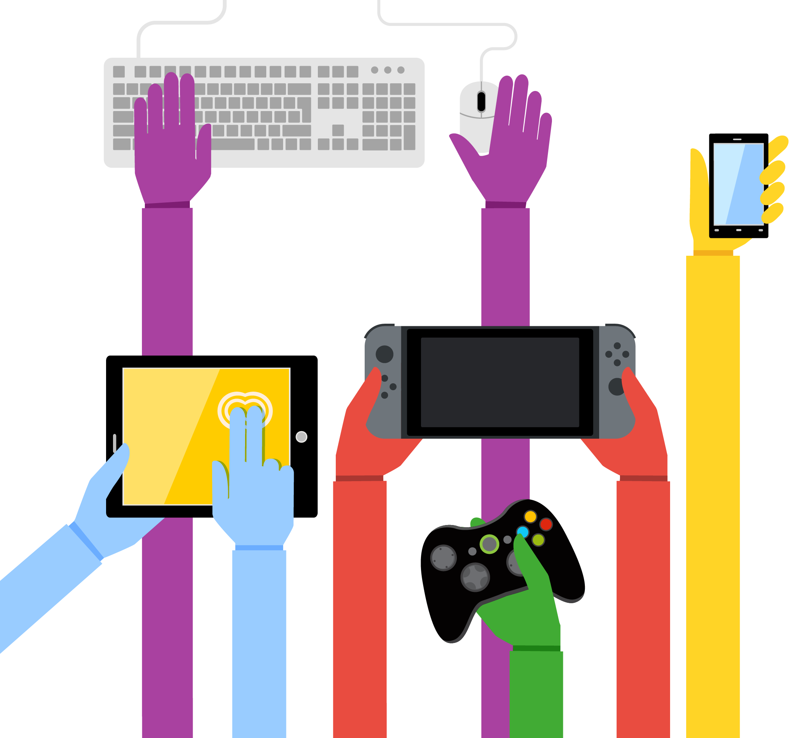



People all over the world use the internet.
So there are lots of different identities online.
58% of people go online!

Slide 12

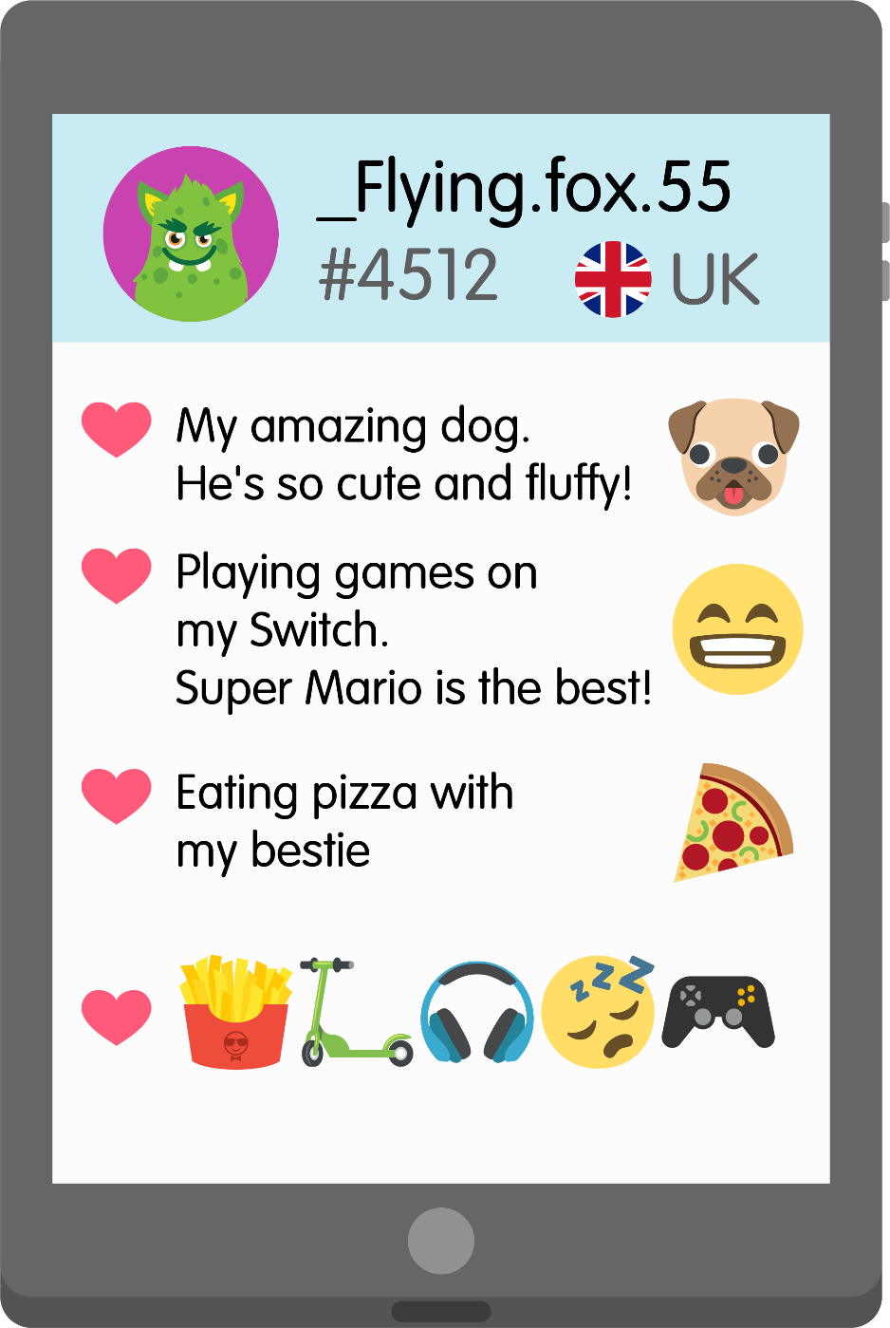
Online identity detectives

Slide 13



There are lots of positive things about changing our identity online:
It can help keep you safe.
You can express yourself.
You can be creative.
It can be really fun!

Slide 14



Always speak to an adult if…
Someone else online has worried or upset you.
You are ever unsure about something you’ve shared online about your identity.
Someone else online has asked you for your personal information or for photos or videos of you.

Slide 15



“I can do whatever I want online, and I can’t get into trouble because it’s my online identity talking not me.”

Slide 16







What have you learnt about online identities today?

Slide 17
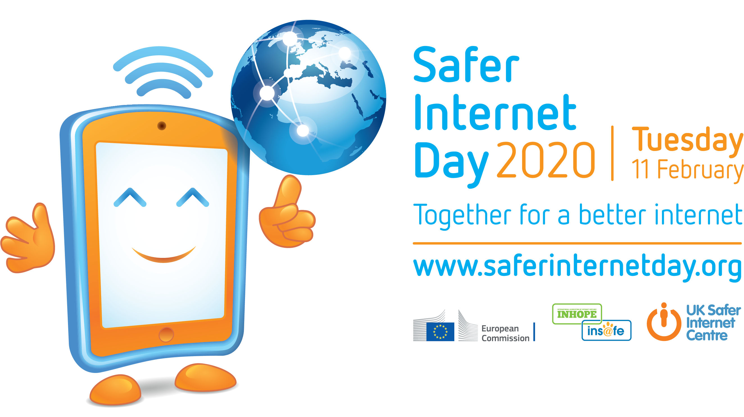

Slide 18
Free to be me
Notes:
Article 17- your right to have honest information
Article 19 – your right to be kept safe from harm
Let's create an internet where we are....
Free to be ourselves
Free to be kind
Free to play
Free to be safe
Free to talk
Let's create an internet where we are....
Free to be creative
Free to be different
Free to feel safe
Free to expect respect
Free to ask for help

